Slide 1
Totals and Spreads Analysis
Andrew Fish

Slide 2
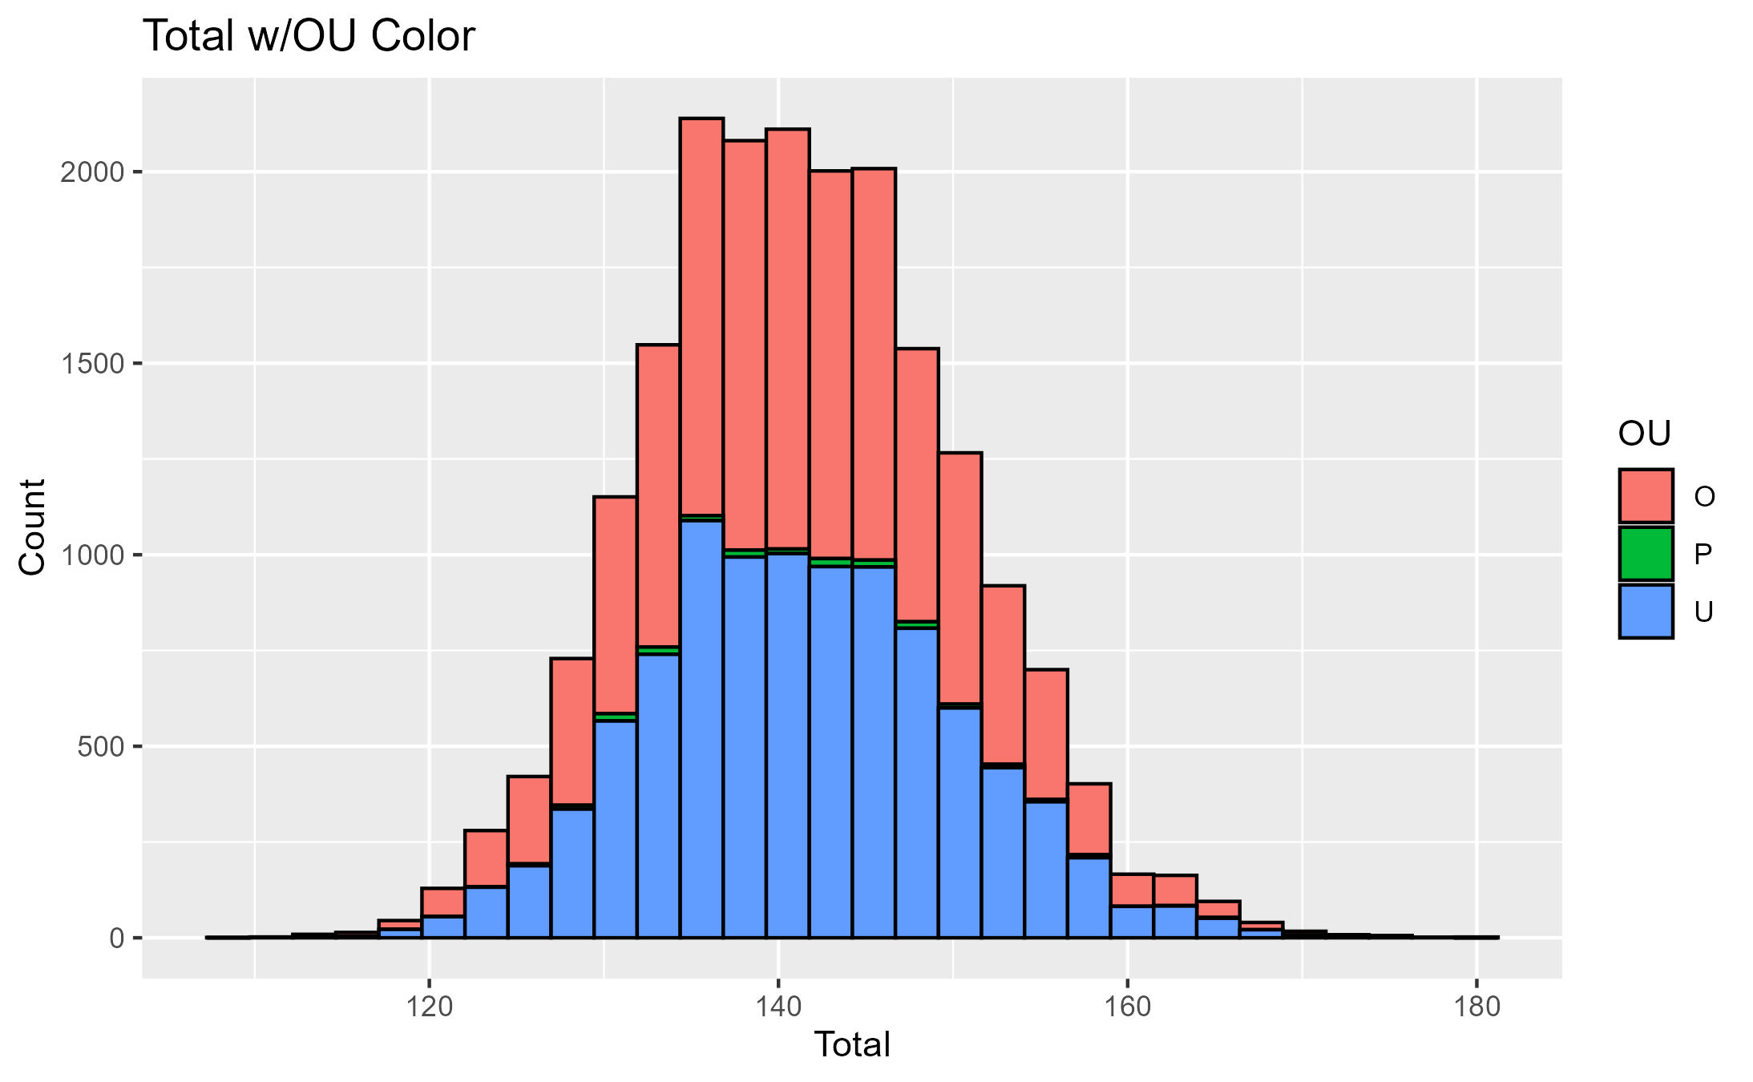
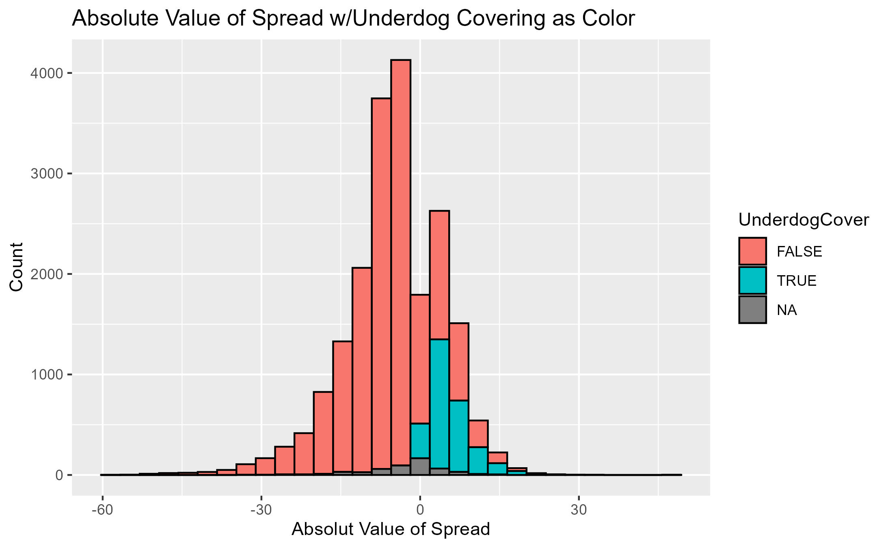
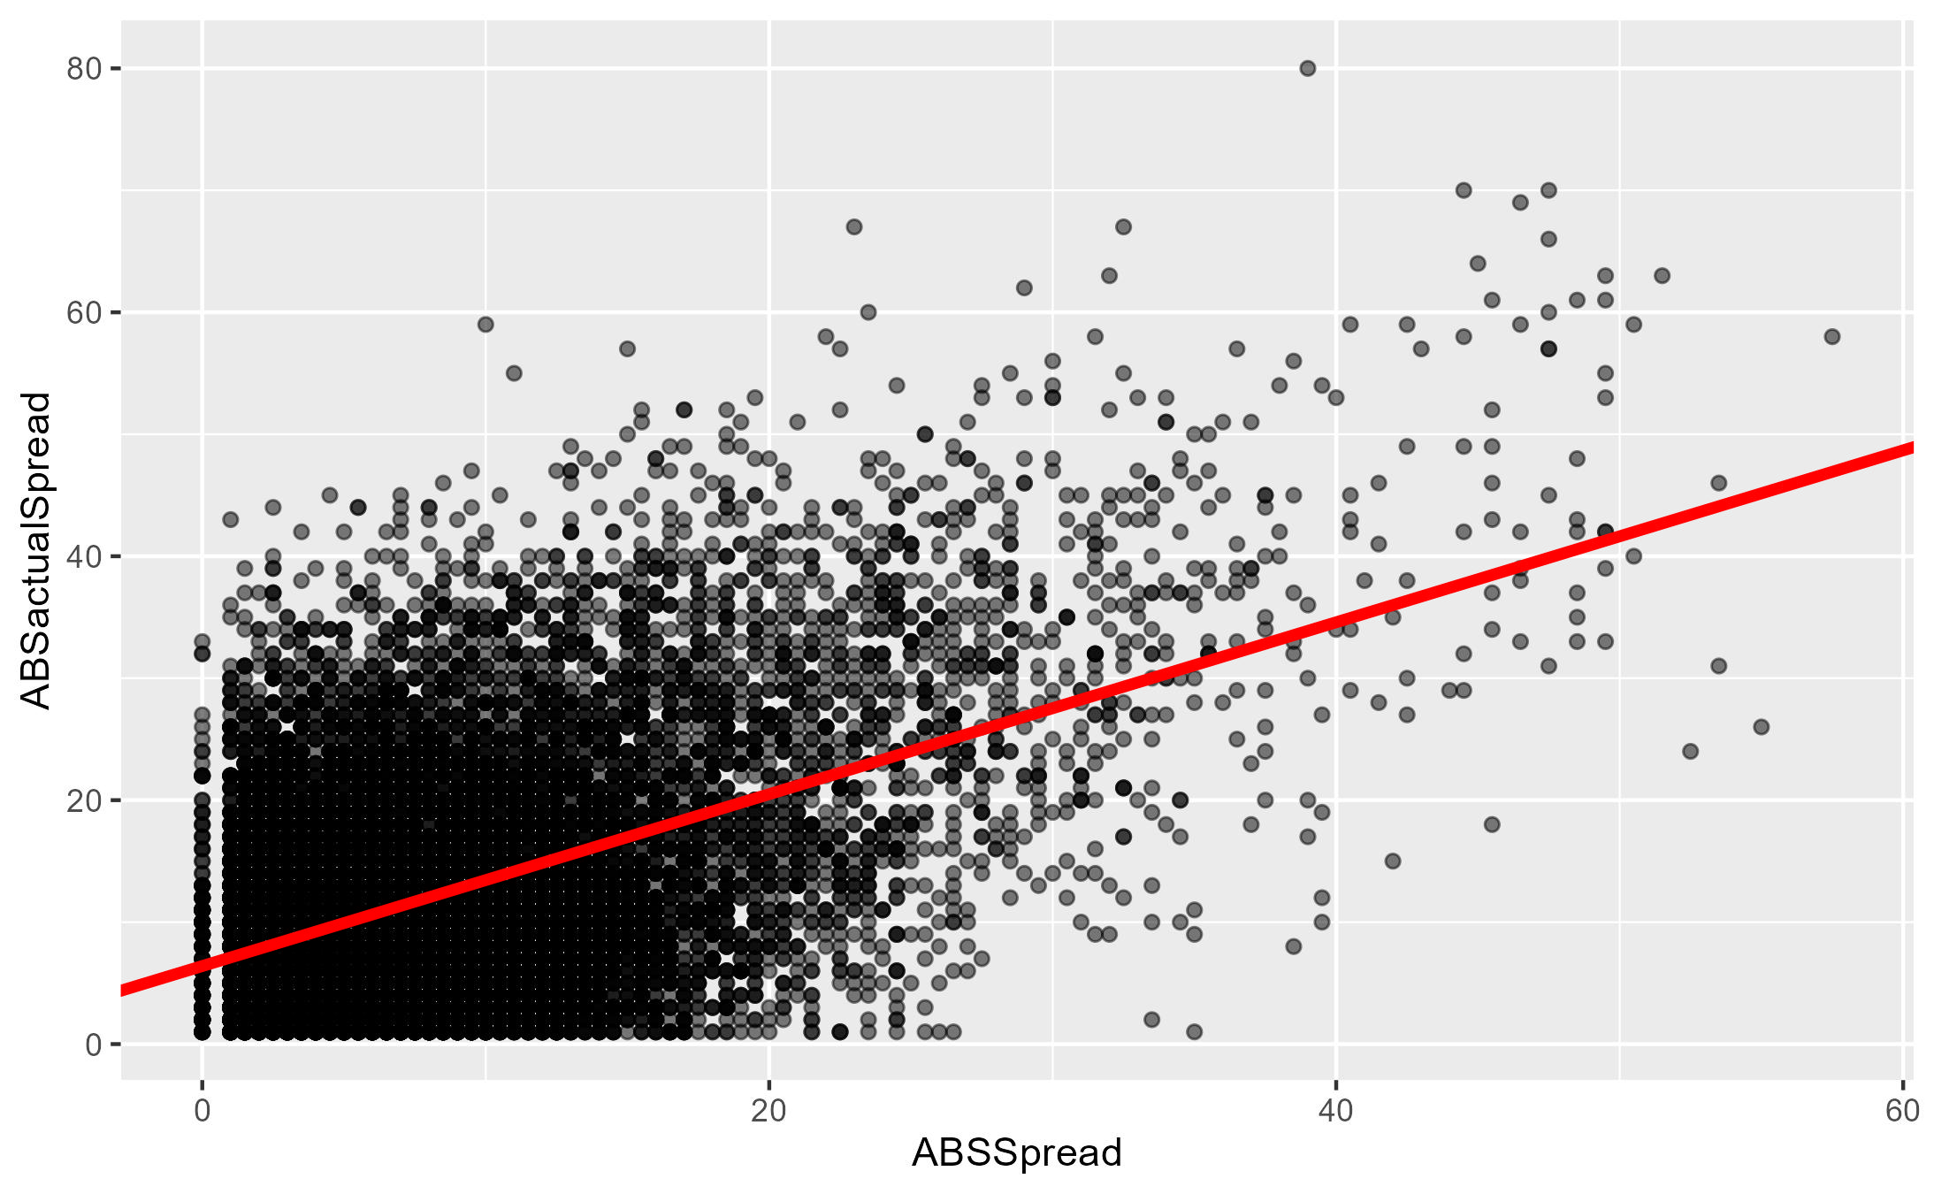
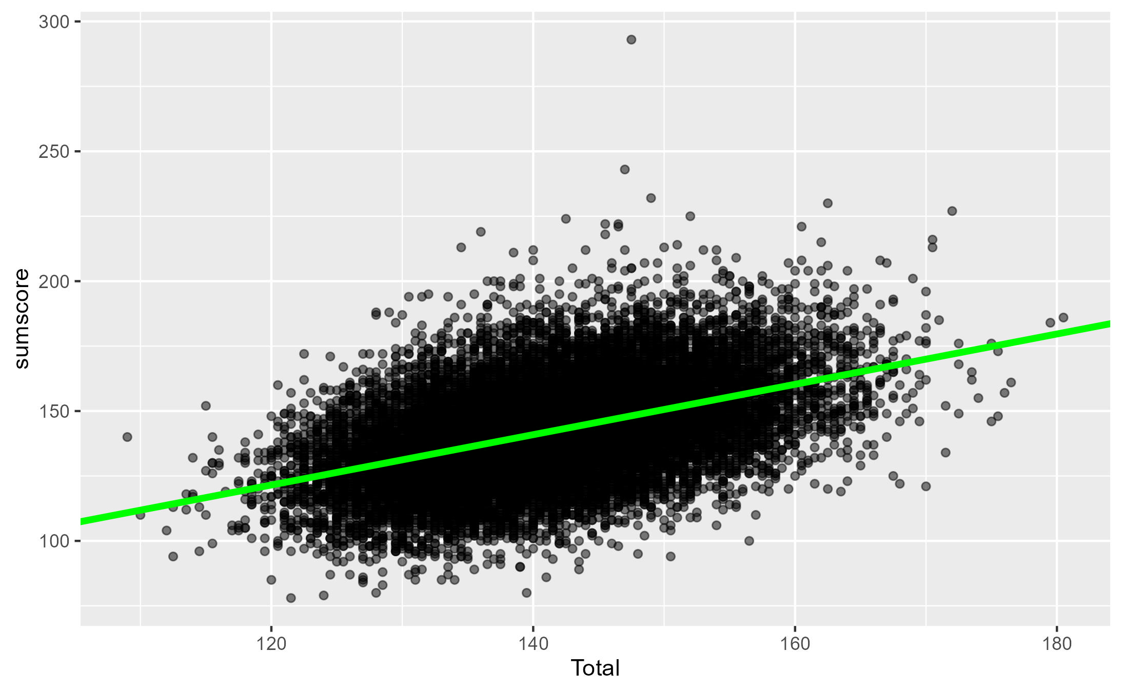
Assumptions of Totals & Spreads
Histograms to show normal distribution of Total and Spread
Scatter plots to show linear relationship between actual and the Vegas Line

Slide 3
Totals – When to Bet the Under
Min | Q1 | Mean | Q3 | Max
109 | 135 | 141.3 | 147 | 180.5
Table 1
Group | Success Ratio | Success Rate
Entire Set | 9743:10061 | 48.7%
Min-Q1 | 2480:2672 | 48.1%
Q3-Max | 2672:2651 | 50.2%
Table 2
Used the quartiles to determine the tails of the distribution and calculated the success rates of the under in each tail. From these calculations the Under is better to bet when the Total is higher. At a certain point there is not enough data in the tail so that is why tail started with the quartiles.

Slide 4
Spreads – When Underdog Covers
*Using Absolute Value of Spread
Min | Q1 | Mean | Q3 | Max
0 | 3.5 | 7.995 | 10.5 | 57.5
Table 1
Group | Success Ratio | Success Rate
Entire Set | 2776:17219 | 13.9%
Min-Q1 | 1198:4769 | 20.1%
Q3-Max | 330:4935 | 6.3%
Table 2
Based on these results it isn’t advantageous to bet the Underdog to cover ever. If still insisting on betting this way it is best to do it when the Spread is lower.

